Slide 1

Udaan
Your flight to clarity
Team: Hack Budhaa
Prewal Fredlin Fernandes
Sneha S Shetty
Sahana S Madival
Amogha H Shetty

Slide 2

Problem Statement
The Unmet Needs of Diverse Learners
Traditional educational materials create significant barriers for students with learning disabilities, language differences, or limited access to resources. This challenge impacts millions of students globally, hindering their potential and perpetuating educational inequity.
Engagement Gap
Accessibility Barriers
Students struggle to connect with static, unadaptable content that doesn't match their learning style.
PDFs and textbooks are often inaccessible to those with dyslexia or visual processing challenges.
Traditional Limitations
Text-heavy, inaccessible, often English-only materials exclude diverse learners.

Slide 3
Our Solution
Personalized, Inclusive Education
Our AI-powered portal transforms standard PDFs into dynamic, accessible learning experiences for every student.
01
02
03
Enhanced Content
Interactive Learning
Comprehensive Management
AI-powered content transformation: Converts PDFs and textbooks into audio, simplified summaries, and multilingual translations tailored to individual needs.
Dyslexia-friendly features: Specialized fonts, customizable overlays, and synchronized read-along highlighting. Plus interactive flashcards and quizzes for engagement.
Dashboards for educators and administrators to manage content, customize materials, and track student progress effectively.
We bridge the gap between traditional content and diverse learning needs, empowering every student to succeed regardless of their learning style or background.

Slide 4
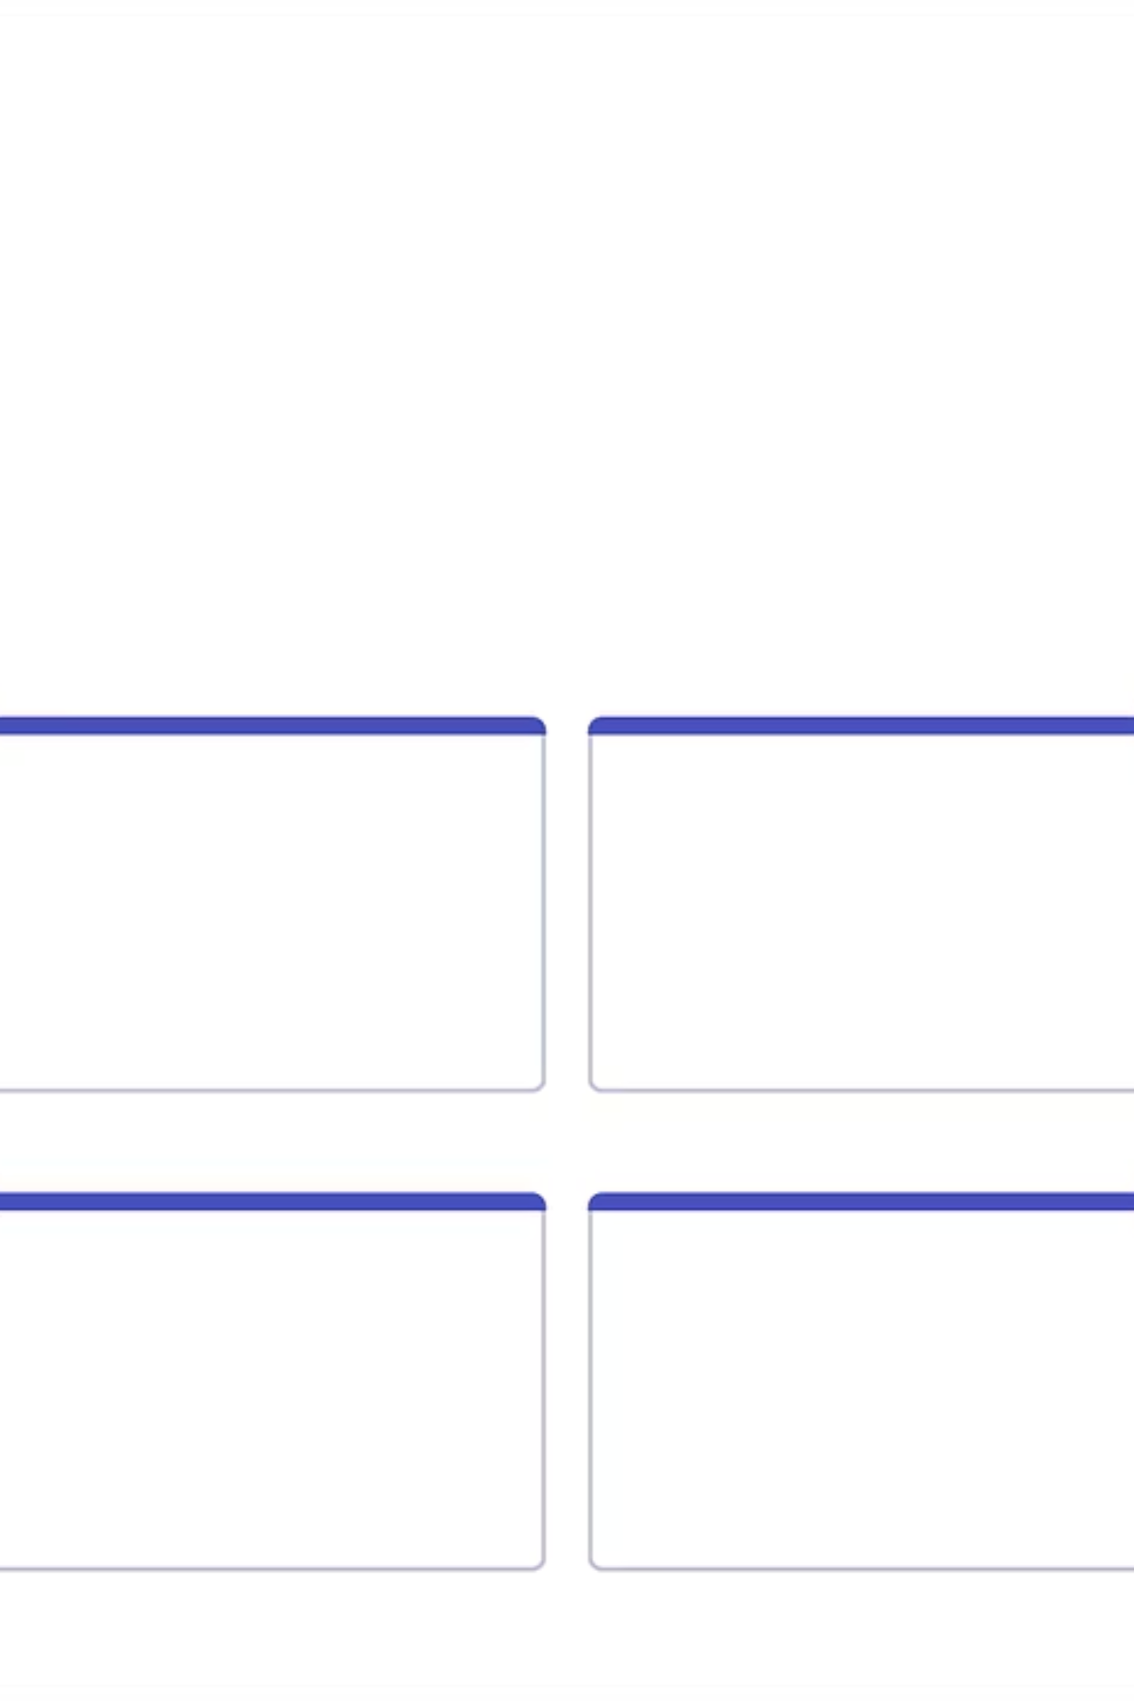
Key Objectives & Goals
Empowering Learners, Expanding Reach
1
Increase Accessibility
Make digital learning materials accessible to students with diverse needs, including dyslexia, ADHD, and visual processing differences.
2
Boost Engagement
Improve student engagement through interactive flashcards, gamified quizzes, and personalized learning experiences.
3
Global Impact
Support learning in different languages, reaching underserved populations worldwide and breaking down language barriers.
4
Foster Inclusivity
Equip educators with study materials that effortlessly adapt content for all learners, creating truly inclusive classrooms.

Slide 5

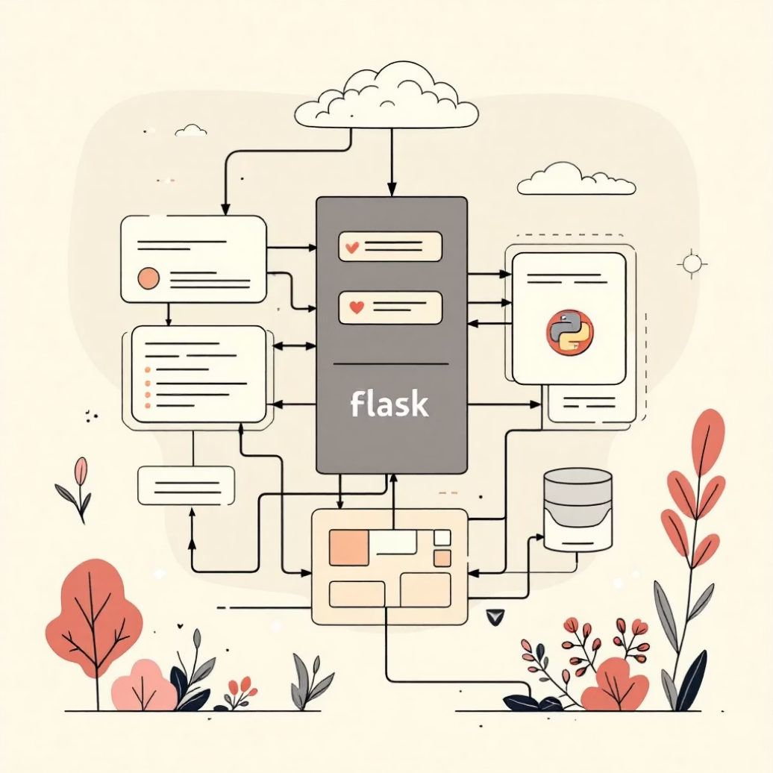
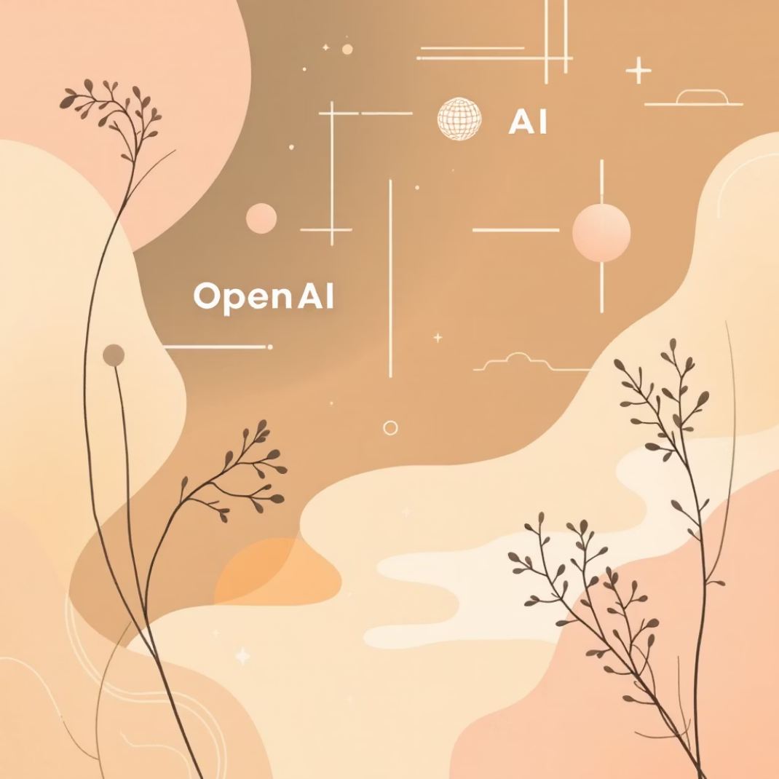
Technology Stack
Cutting-Edge Tools for a Seamless Experience
Our modular, database-based architecture, powered by React, Flask, and the OpenAI API, ensures flexibility and rapid deployment for continuous innovation.
Frontend: HTML5 and CSS3
Backend: Flask
AI Core: OpenAI API
Dynamic and responsive user interfaces designed for optimal learning experiences across all devices.
Robust and scalable backend infrastructure for seamless data management and application logic.
Leveraging advanced AI capabilities for intelligent content transformation and personalized learning features.

Slide 6
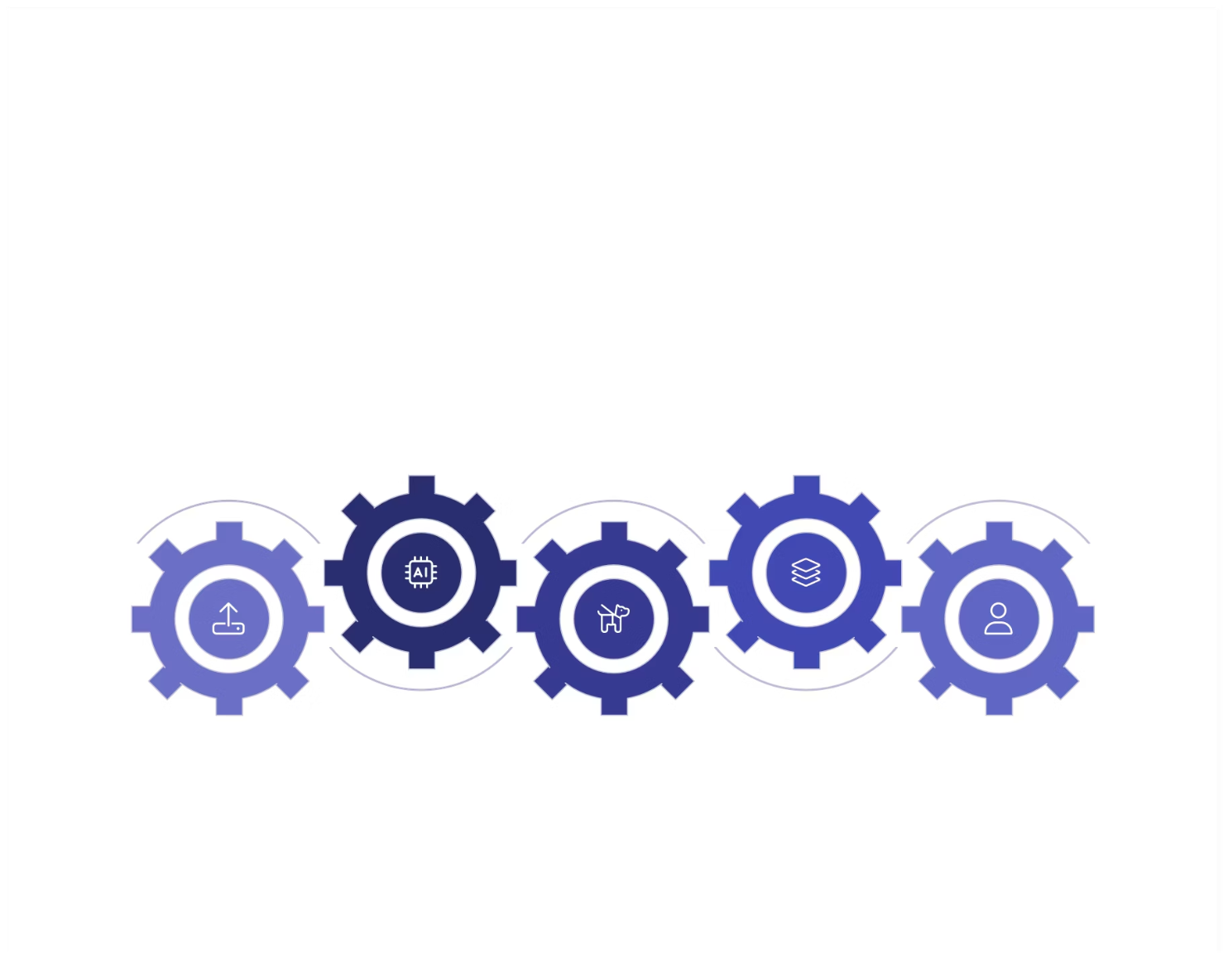





System Workflow & Architecture
Transforming Content, Empowering Learning
Upload PDF
User submits source document through our intuitive interface
AI Processing
Summarize, translate, and format content using advanced AI algorithms
Adapt for Dyslexia
Apply accessible formatting and specialized features for diverse learning needs
Generate Outputs
Create modules, audio content, and gamified learning experiences
Deliver to User
Provide interactive learning experiences tailored to individual preferences

Slide 7





Key Features & Innovation
Redefining Educational Accessibility
AI-Powered Transformation
Multilingual Support
Personalized Learning Paths
Automated conversion of PDFs to diverse formats: audiobooks, simplified summaries, and real-time translations for global accessibility.
Instant translation into different languages, breaking down language barriers and making education accessible to learners globally.
Adaptive content delivery based on individual student needs, preferences, and learning styles for maximum engagement.
Educator Dashboard
Dyslexia-Friendly Interface
Comprehensive tools for teachers to customize content, track student progress, and monitor accessibility metrics effectively.
Customizable fonts, line spacing, color overlays, and synchronized highlighting designed specifically for improved readability.

Slide 8

Implementation Plan
Our Roadmap to Launch and Beyond
1
Phase 1: Concept & Prototype (Q1 2024)
Develop core AI conversion engine, build basic UI, and conduct initial user testing with educators and learning specialists.
2
Phase 2: Alpha Testing & Feature Expansion (Q2-Q3 2024)
Integrate dyslexia-friendly features, gamification elements, and multilingual support. Expand testing to select schools and gather feedback.
3
Phase 3: Beta Launch & Pilot Programs (Q4 2024)
Full platform launch for pilot schools and early adopters. Gather extensive feedback for refinement and optimization.
4
Phase 4: Public Release & Scaling (Q1 2025)
General availability launch. Begin strategic partnerships with educational institutions and expand marketing efforts to reach a broader audience.

Slide 9

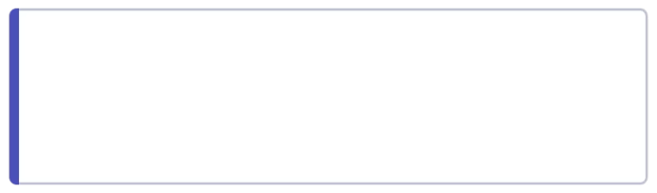
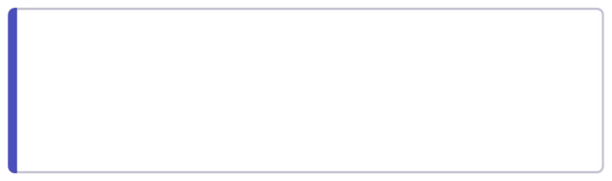
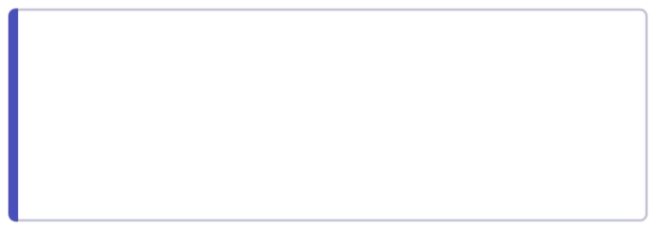
Challenges & Risk Management
Anticipating Obstacles, Ensuring Success
AI Accuracy & Bias
Data Privacy & Security
Ongoing model training, diverse datasets, and human oversight to ensure factual accuracy and fairness across all content transformations.
Strict encryption protocols, compliance with educational data regulations (FERPA, GDPR), and regular security audits to protect student information.
Adoption & Integration
User-friendly design, comprehensive training programs for educators, and seamless integration with existing LMS platforms to ensure smooth adoption.

Slide 10


Impact & Conclusion
A Brighter, More Inclusive Future for Education
Our GenAI solution isn't just a tool—it's a catalyst for educational equity. By transforming how students access and interact with learning materials, we unlock potential, foster engagement, and pave the way for a truly inclusive global classroom.
Join us in building a world where every learner can thrive. Together, we can ensure that learning disabilities, language barriers, and resource limitations never again limit a student's potential to succeed.

